Slide 1

PROGRESS PRESENTATION ON
RESTAURANT MANAGEMENT SYSTEM
Software Engineering Project
Team Members:
Amarjeet Kumar Singh
Phungkha Basumatary
Rwikhamuti Basumatary
Bhagyashree Nath
Jyoshna Rani Roy
Instructor: Prasanta Baruah
Assistant Professor, Dept. of CSE

Slide 2
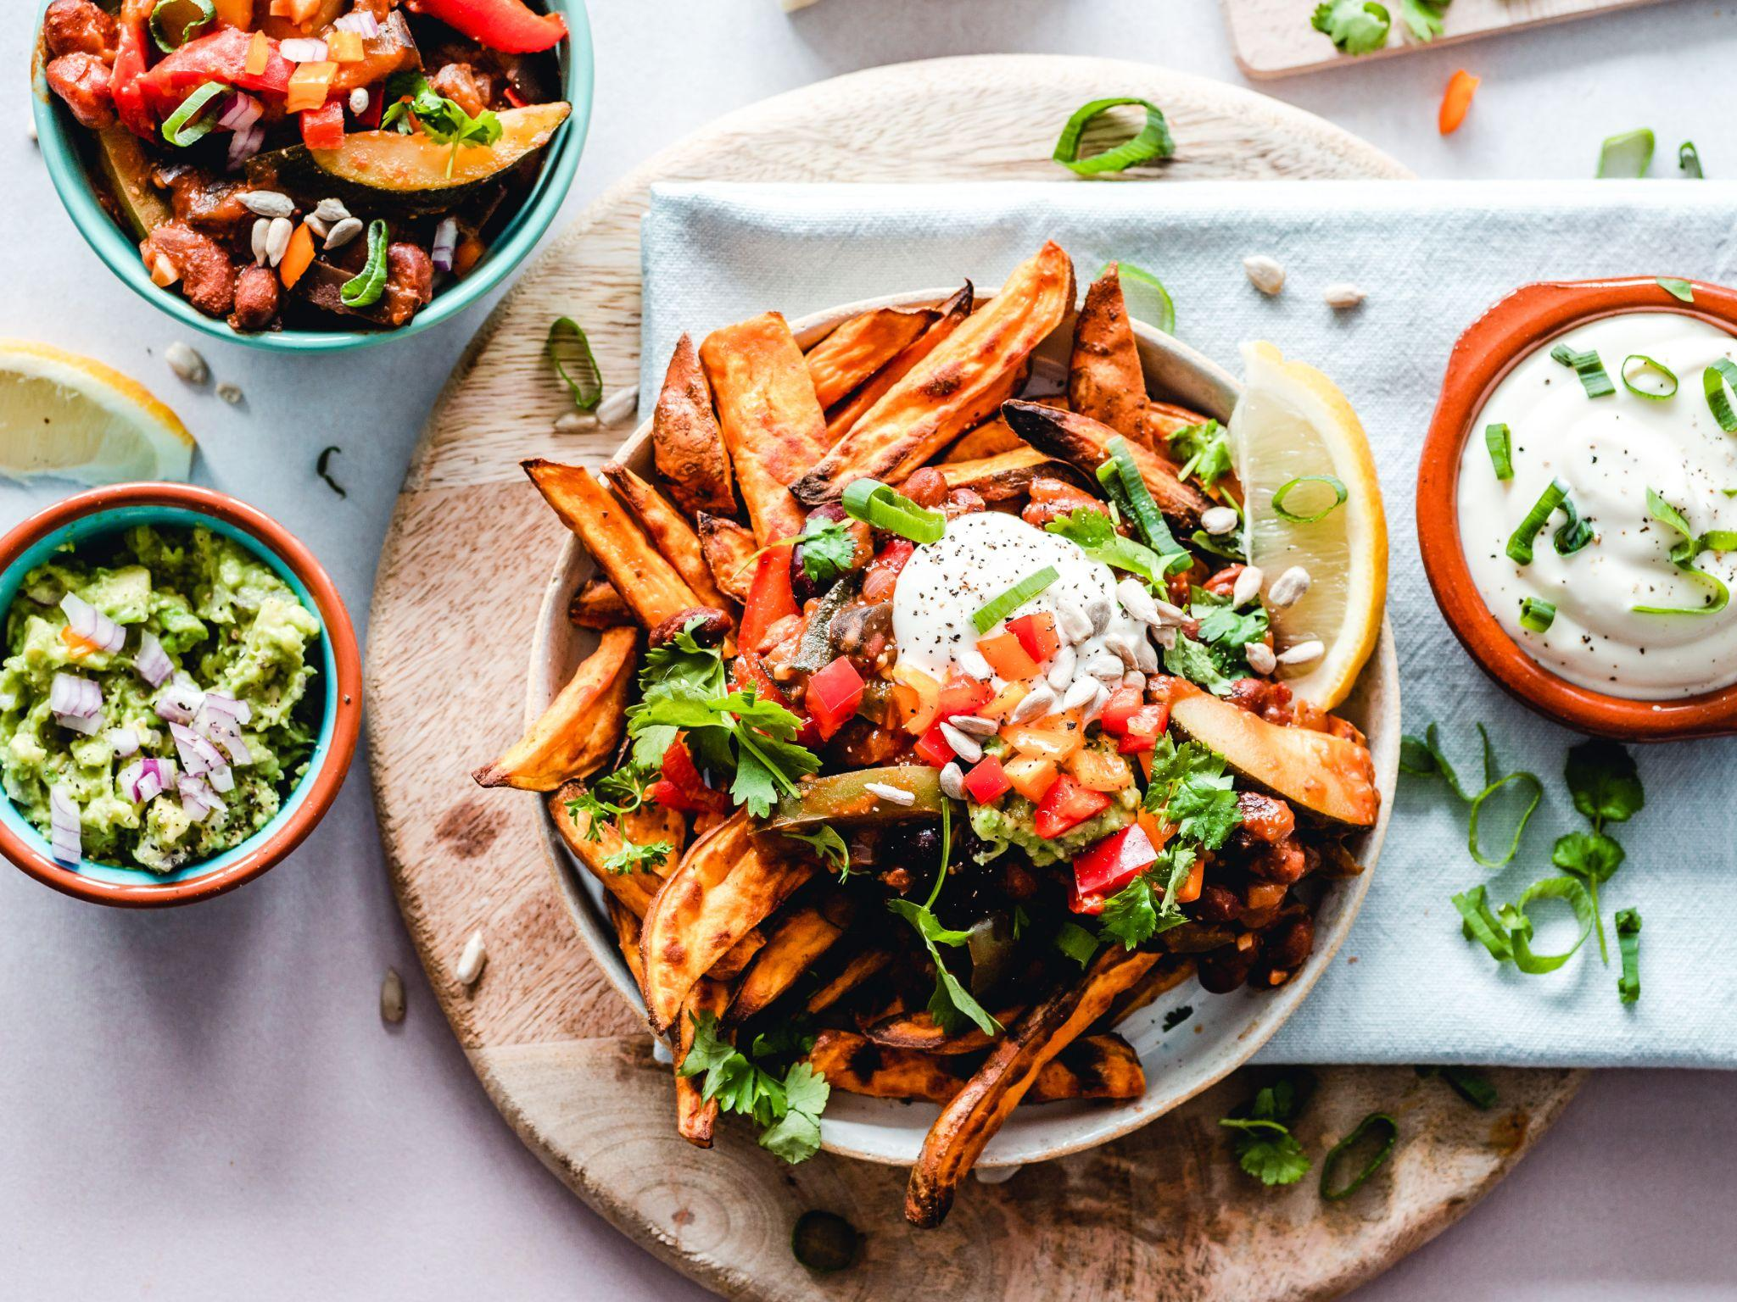
OVERVIEW
Introduction
Objective
How The System Works
Interface
Work done
Future work

Slide 3
INTRODUCTION
To increase service quality of a restaurant
Customer order menu at the table by itself
What is smart restaurant system
Menu shown on the UI will send to kitchen
Food and drink sent by waiter shortly

Slide 4
OBJECTIVES
Increase Customer Comfortability
Customer Can take their time when order the menu
Reduce labour into a minimum needed
Encourage of restaurateur to use modern technology System
Reduce mistake made by waiters

Slide 5
How The System Works
Initially user have to register into the application
Once User is registered they can login into the application
After login they can order food items showing different details
Food availability is showing in UI
The order ID will be generated
The details like login credentials, ordered food etc will be stored in MySQL Database
Once order reached to the kicken, Restaurant can move forward with next steps.

Slide 6
Technology Used
MySQL is used as Database to store all the Information
SQL is used as Query language to retrieve and store data
PHP is used as a Backend Language to process data from frontend to backend and vice versa.
CSS is used to design the User Interface
HTML is used to show content in User Interface
XAMPP Platform is used for running Apache Server

Slide 7
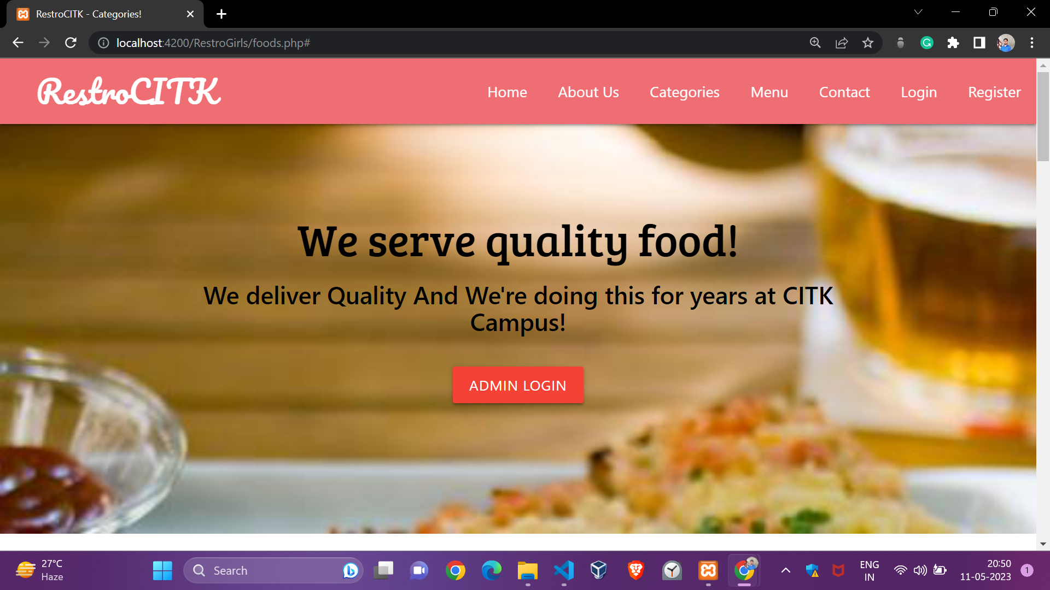
USER INTERFACE

Slide 8
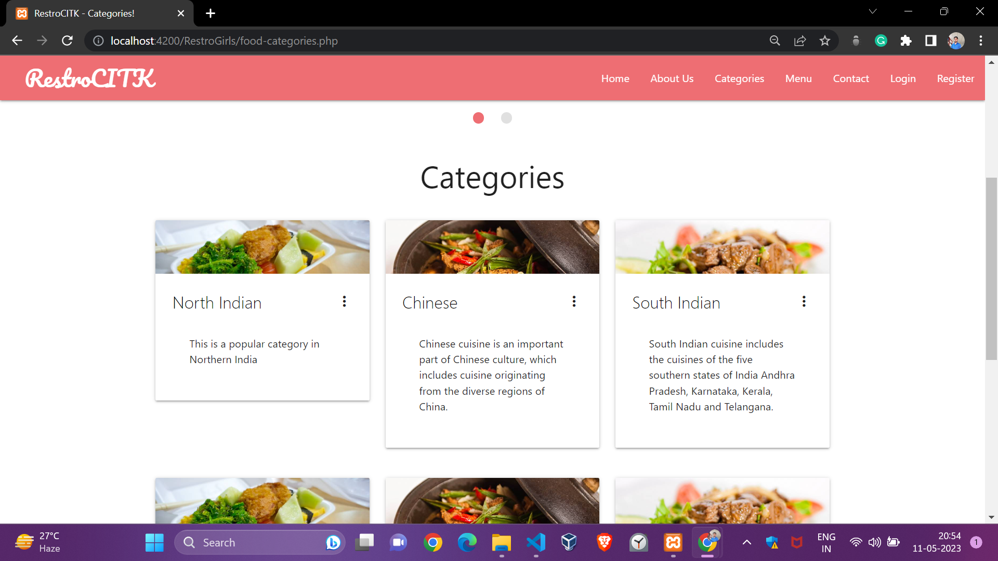
Categories of Foods

Slide 9
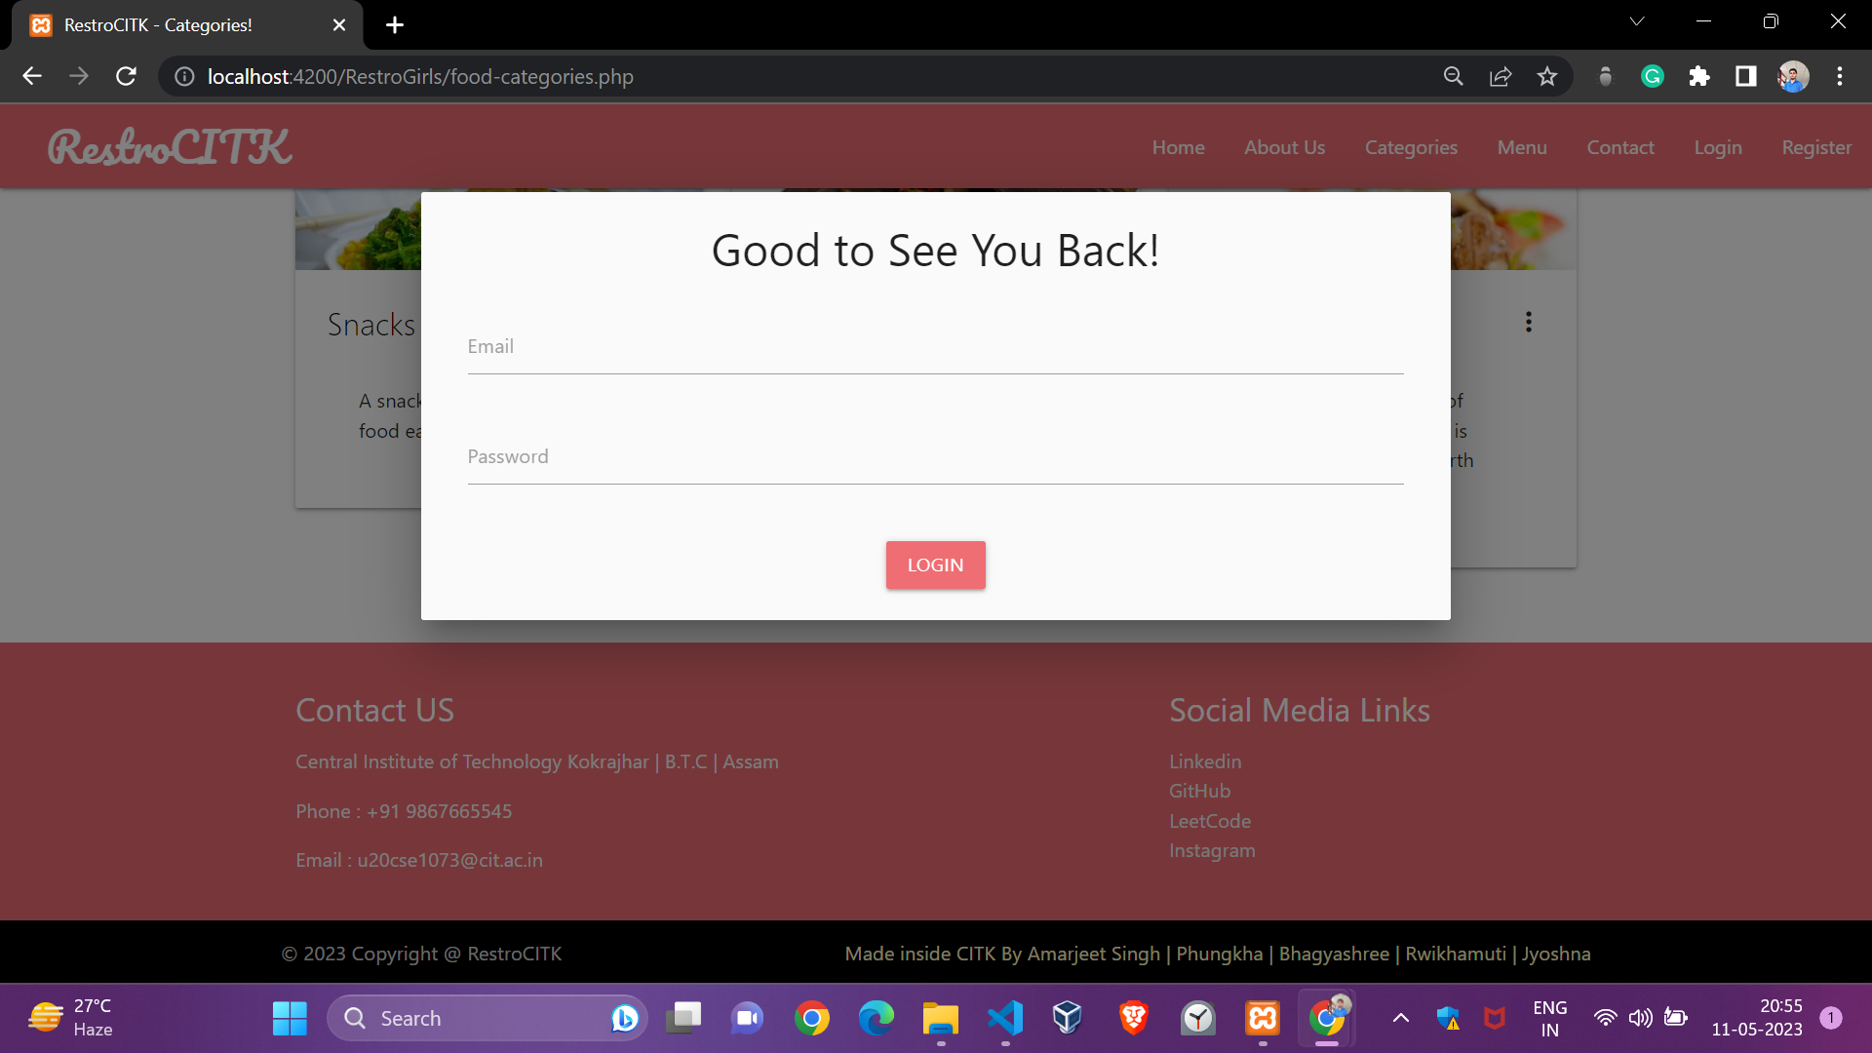
Customer Login System

Slide 10
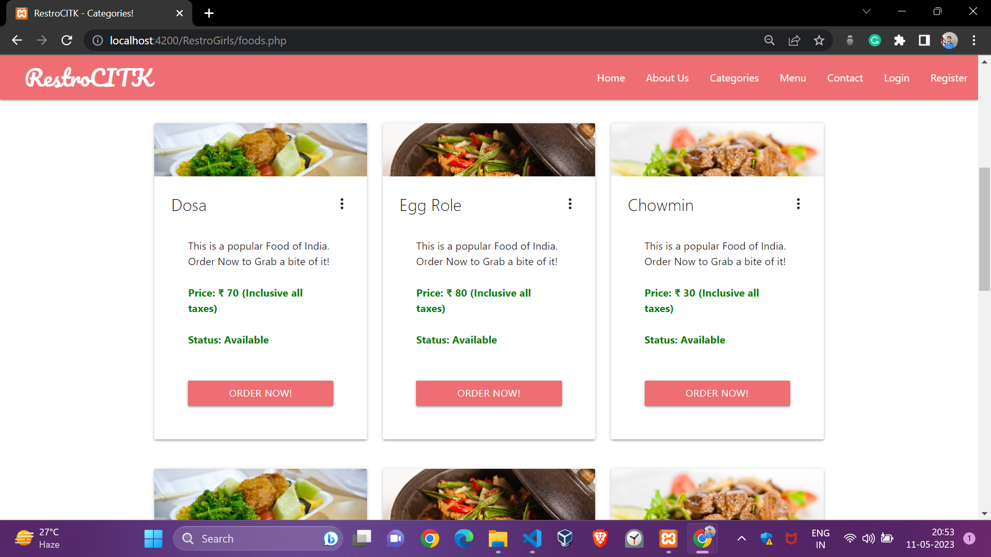
Food Menu

Slide 11
WORK DONE
Till date, Following functionalities have been implemented:
Registration, Login and User authentication
Food categories section
Menu section
Header & Footer
Order making

Slide 12
WORK TO BE DONE
Following Things has to be done:
Order Processing
Admin User Interface
New Food Category Creation
New Menu Creation
Deletion of existing menu

Slide 13
Thank You…

